Slide 1


CSE 455 Software Testing
Lecture 9
This course is offered to the students of students of BS Software Engineering who are enrolled in 8th semester

Slide 2
Course instructor Yella mehroze
yellamehroze@cuilahore.edu.pk

Slide 3
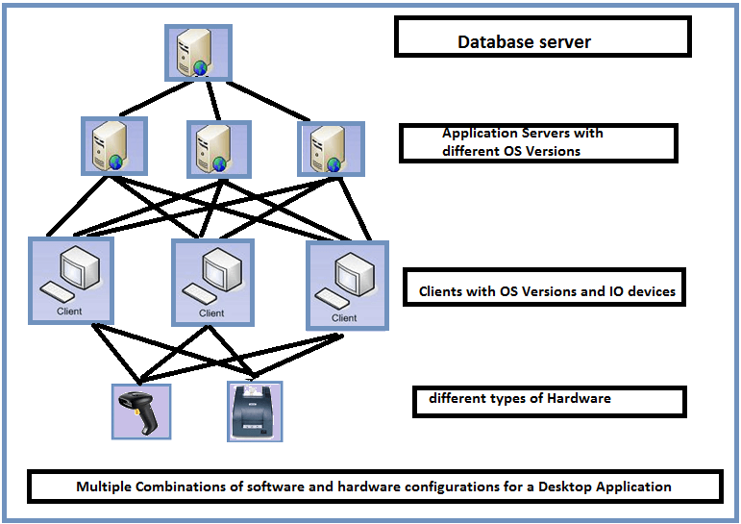
Configuration Testing

Slide 4
Outline
Configuration Testing Objectives
Introduction
Configuration Possibilities
Why we need configuration testing
Isolating configuration Bugs
Sizing up the Job
Configuration Testing Planning

Slide 5
Configuration Testing Objectives
To determine whether the software application fulfils the configurability requirements.
To identify the defects that were not efficiently found during different testing processes.
To minimalize the number of failures due to host configuration errors.
To determine an optimal configuration of the application under test.
To do analysis of the performance of software application by changing the hardware and software resources.

Slide 6
Introduction
Computer superstores are offering PCs, printers, monitors, network cards, modems, scanners, digital cameras, peripherals, net-cams and hundreds of other computer related products from thousands of companies.
During testing, you make sure that your software works with as many different hardware components as possible.
If you are not testing your software for a particular hardware platform such as a PC or MAC, you still need to consider configuration issues
Example-System/ Configuration requirements for a game can be
6th Gen Intel(R) Core(TM) i5
1920 x 1080 Screen Resolution
NVIDIA GeForce GTX 950M 4GB Discrete Graphics
B&O (Bang & Olufsen) PLAY with 2 speakers
Image pad with multi-touch gesture support
Notes:
Here I would like you to recall the Motivational story of The Lion King Animated game which we discussed in the start of this course. The game could not run on many PC’s as it was not tested for multiple PC platforms.
So if you ignore the configuration testing, you will have to face such problems.
GeForce is a brand of graphics processing units (GPUs) designed by Nvidia.

Slide 7
Configuration Testing
Configuration testing is the process of checking the operation of the software you are testing with all these various types of hardware and above
Notes:
So the purpose is to identify minimum possible age and model of the hardware at which the system can work.

Slide 8
Configuration Possibilities
The PC/ System
Components
Peripherals
Interfaces
Options and Memory
Device Drivers

Slide 9
Configuration Possibilities
The PC/ System
There are well known computer manufacturers such as Gateway, HSP, Dell etc
Each one builds PC using components designed themselves or obtained from other manufacturers
Some Hobbyists build their own PCs using off-the-shelf components
Components
PCs are built up from various system boards, component cards and other internal devices that include:
CD-ROM Drives
DVD Burners
Video
Sound
Fax Modems
Network Card
Notes:
Some components are built by manufacturer brands themselves while others are purchased from other manufacturers. Like in HP laptop some components used are made by HP while other components are provided by different brands.
You can also order custom made PC’s in which you can demand components like processor, RAM, Memory, Network and Graphics Card etc. according to your need.

Slide 10
Configuration Possibilities
Peripherals
Printers
Scanners
Mouse
Keyboards
Monitors
Cameras
Joysticks
These devices are plugged into system and operate externally

Slide 11
Configuration Possibilities
Interfaces
Components and peripherals plug into your PC through various types of interface connectors
Interfaces can be internal or external to the PC and include
ISA (Industry Standard Architecture)
PCI (Peripheral Component Interface)
USB
PS/2
RS-332
RJ – 11
RJ – 45
Firewire
Hardware manufacturers often create the same peripheral with different interfaces
For example its possible to buy the exact same mouse in three different configurations
Notes:
ISA (Industry Standard Architecture)- It is a bus that allowed the computer to detect peripherals, such as a modem or sound card
PCI (Peripheral Component Interface) It holds your CPU and chipset, and provides an interface for other components of the computer.
PS/2 This is an old port for connecting mouse and keyboard
RS-332 It connects DTE (Data Terminal Equipment) to DCE (Data Circuit-terminating Equipment) for data transmission
DTE is the equipment which terminates flow of information in any communication network. Exemples: Terminals, computers, laptops, routers, bridges etc.
Where as DCE is the equipment which transports information over communication medium. EXAMPLES: Modem, Switch etc.
So in other words RS-332 connects components like computers, laptops etc to modems and switches.
RJ – 11
RJ – 45
These are network connectors.
Firewire This is a cable used to transfer information between digital devices

Slide 12
Configuration Possibilities
Options and Memory
Many components and peripherals can be purchased with different hardware options and memory sizes
For example printers can be upgraded to support extra fonts or accept more memory to speed up printing
Graphics cards with more memory can support additional colors and higher resolutions
Device Drivers
All components and peripherals communicate with the operating system and software application through low-level software called device drivers
These drivers may be provided by hardware device manufacturer
These drivers are installed when you set up the hardware
Technically they are software, for testing purpose they are considered part of the hardware configuration

Slide 13
How to decide Configuration Possibilities
For configuration testing of a software Identify configuration areas most closely tied to program
Examples:
A graphical computer game will require lots of attention to the video and sound areas
A greeting card will be vulnerable to printing issues
A fax or communication program will need to be tested with numerous modems and network configurations

Slide 14
Why we need configuration testing
You expect that everyone designed their hardware to a set of standards and software would work with it without any problems (Ideal Situation)
Unfortunately standards are not always followed
The result is software does not work correctly with certain hardware configurations
Notes:
For example: The operating system that you want to install on your PC follows the standards and guidelines of windows. But the PC manufacturer has not followed the manufacturing and quality standards. So you would be unable to install operating system. You will get multiple installation errors because the components will not support that operating system.

Slide 15
Isolating configuration Bugs
Whenever you discover a problem, a question arises, who should fix the bug- your team or the hardware manufacturer?
This is a million dollar question
First you should figure out where the problem lies.

Slide 16
Isolating configuration Bugs
Reasons of Configuration Problems
Case 1:
Case 2:
Your software may have a bug that appears under a broad class of configurations.
Your software may have a bug specific only to one particular configuration
Notes:
Case 1 Example: if your greeting card program works fine with laser printers but not with inkjet printers
Case 2 Example: software does not work on the HP Deskjet 3545 Printer

Slide 17
Isolating configuration Bugs
Case 3:
Case 4:
The hardware device or its device drivers may have a bug that only your software reveals.
The hardware device or its device drivers may have a bug that can be seen with lots of other software.
Notes:
Case 3 Example: May be your software is the only one that uses a unique display card setting. When your software is run with a specific video card, the PC crashes
Case 4 Example: A specific printer driver always defaulted to draft mode and your photo printing software had to set it to high quality every time.

Slide 18
Isolating configuration Bugs
Who should fix Bugs?
Case 1& Case 2:
Project team is responsible for fixing the bug
Case 3 & Case 4:
The last two cases seem blurry
Say the bug is in printer and that is popular one in the world. It may take the printer vendor months to fix the bug. So you need to make changes to your software
Its your team’s responsibility to address the problem, no matter where it lies.
Your customers just want the software they purchased to work on their system’s configuration without caring for how the bug is happening
Notes:
Let’s say you report the bug to printer customer support centre. There will be a chain of command to be followed before fixing the bug. The longer the chain of command, the more difficult and time taking it will be to resolve the problem.

Slide 19
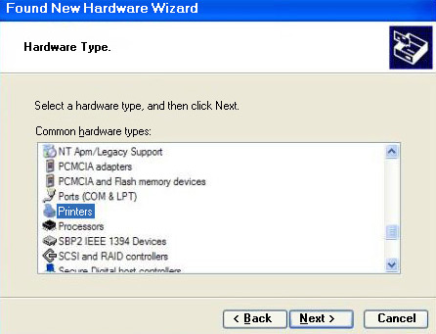
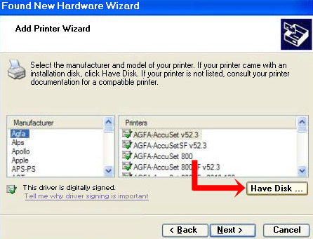
Sizing up the Job
The job of configuration testing can be a huge undertaking.
Suppose you are testing a new software game that runs under Microsoft windows
For game you will need to consider configuration testing with graphics cards, sound cards, modems and printers
The windows Found New Hardware Wizard allows you to select hardware in each of these categories
Under each hardware category are the different manufacturers and models with support built into windows
If you decide to perform a full, comprehensive configuration test, checking every possible make and model combination is a huge job
Notes:
Here in the picture, you can see a hardware wizard for printer. In the picture at the top you can select the hardware that is printer and in the picture at the bottom you can select the manufacturer and then model of the printer against the manufacturer.

Slide 20
Sizing up the Job
Example:
If you limited your testing to exclude combinations, just testing each card individually (Example: Display Cards) at about 30 min. / configuration, you would be at it for about a year
Then it is not uncommon with bug fixes to run two or three configuration test passes
The solution to this mess is equivalence partitioning
You have to figure out set of possible configurations to the ones that matter the most
No of Display Cards
No of Sound Cards
No of Modems
No of Printers
336
210
1500
1200
No of Test Combinations = 336 * 210 * 1500 * 1200

Slide 21
Configuration Testing Planning
Decide the types of hardware
Decide the hardware brands, models and device drivers
Decide the hardware features, modes and options
Pare down the identified hardware configurations to a manage-able set
Identify your software’s unique features that work with the hardware configurations
Design the test cases to run on each configuration
Execute the tests on each configuration
Rerun the tests until the results satisfy your teams
Notes:
Decide the types of hardware you will need
Decide what hardware brands, models and device drivers are available
Decide which hardware features, modes and options are possible
Pare down the identified hardware configurations to a manageable set
Identify your software’s unique features that work with the hardware configurations
Design the test cases to run on each configuration
Execute the tests on each configuration
Rerun the tests until the results satisfy your teams

Slide 22
1. Decide the types of hardware you will need
Decide what hardware pieces you need to put together to make your software work
If your application is to print, you need to test printers
If it has sound, you need to test sound cards
If it has photos or graphics program, you will need scanners and digital cameras

Slide 23
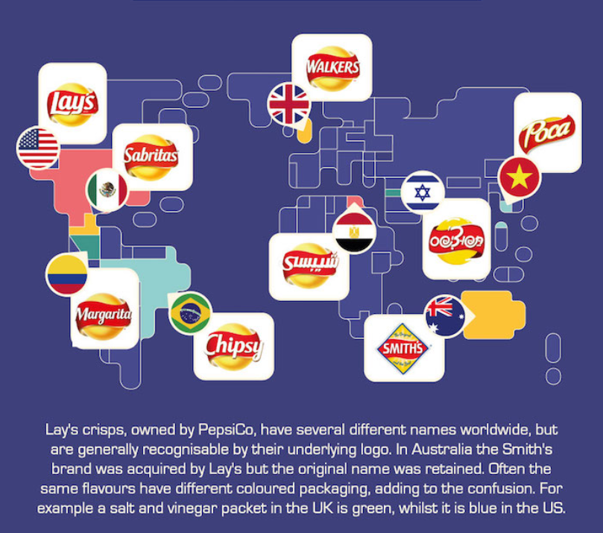
2. Decide what hardware brands, models and device drivers are available
Work with your sales and marketing people to create a list of hardware to test with
If they can’t help, check out the recent requirement reviews from PC Magazine or Mac World to get an idea of what hardware available and what is popular. These magazines have annual reviews of printers, sound cards, display adapters etc
Do some research to see which devices are equivalent, falling under same equivalence partitioning
For example, a printer manufacturer may license their printer to another company that puts a different label or cover on it. Actually it’s the same printer
Decide what device drivers you are going to test with

Slide 24
3. Decide which hardware features, modes and options are possible
Every device has features, mode and options and your software may not need to support all of them
For example:
Printers:
Color printers can print in black and white or color
Printers can print in different quality modes and can have settings for printing photos or texts
Display cards
Can have different color settings and screen resolutions
Computer games
Require minimum no of display colors and resolution.
There is usually a set of minimum requirements for hardware features, modes and options. If configuration has less than that, they won’t run

Slide 25
4. Pare down the identified hardware configurations to a manageable set
Reduce thousands of potential configurations into the ones that matter
One way to do this is to put all the configuration information into a spreadsheet
Popularity (1=most , 10 =least) | Type (Laser/ Inkjet) | Age (Years) | Manufacturer | Model | Device Driver Version | Options | Options
1 | Laser | 3 | HAL Printers | LDIY2000 | 1.0 | B/W | Draft Quality
5 | Inkjet | 1 | HAL Printers | IJDIY2000 | 1.0a | Color B/W | Draft Quality
5 | Inkjet | 1 | HAL Printers | IJDIY2000 | 2.0 | Color B/W | Art Photo Draft Quality
Notes:
You and your team can review the table and decide which configuration(s) you want to test
The table contains information about the device’s Popularity, its Type, Age, Manufacturer, Model, Device Driver Version and different Options.
Based on information, you might decide that you want to test only the most popular printers or the ones that are less than five years old
On the basis of type of information you might decide to test 75 percent lasers and 25 percent inkjets
Similarly you can take decisions based on any information category of the device.

Slide 26
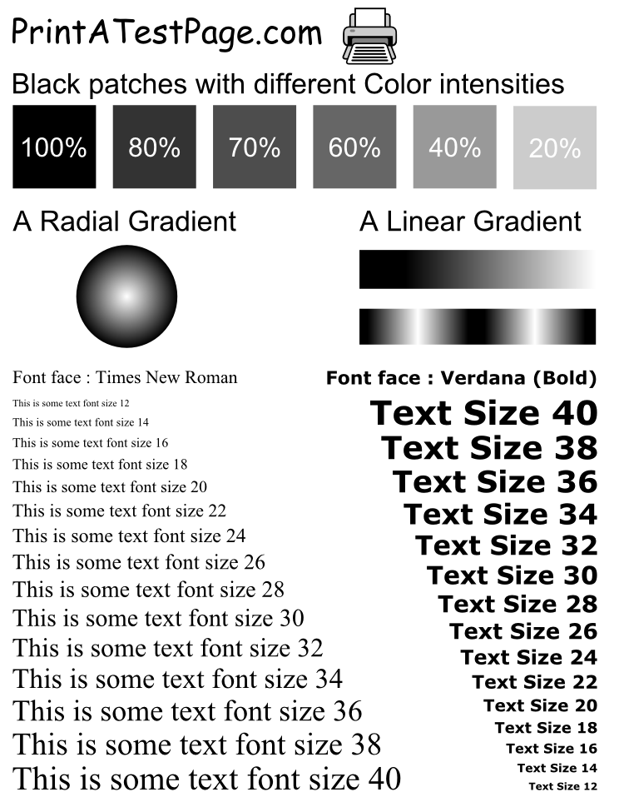
5. Identify your software’s unique features that work with the hardware configurations
The focus here is on ‘unique’
Test only those features that are different from each other that interact with the hardware
Example- while testing a word processor as WordPad, you don’t need to test the file save and load feature in each configuration.
A good test would be to create a document that contains different fonts, point sizes, colors, embedded pictures and so on
You would attempt to print this document on each chosen printer configuration
Notes:
The picture on the right side is although black and white but it has different font sizes, font style, bold, colour gradients, colour intensities and a picture to test a print. You can test more options like italics, paragraph indentations, different shapes, graphs and much more.

Slide 27
6. Design the test cases to run on each configuration
Steps for Configuration Test Cases
Select and set up the test configuration from the list
Start the software
Load in the file configtest.doc
Confirm that the file is displayed correctly
Print the document
Confirm that there are no error messages
Log any discrepancies as a bug
Confirm that the printed document matches the standard
The goal is to create steps that anyone can run

Slide 28
7. Execute the tests on each configuration
Run test cases, log and report results to your team and hardware manufacturer
It is difficult and time consuming to identify the specific source of configuration problems
Work closely with programmers and white-box testers to isolate the cause and decide if the bugs are due to your software or to the hardware
If the bug is specific to hardware, consult the manufacturer’s website for reporting problem
Identify yourself as a software tester and what company you work for
The other company from which the hardware belongs, may ask you to send copies of your test software, your test cases, and supporting details to help them isolate the problem

Slide 29
8. Rerun the tests until the results satisfy your teams
Entire course of the project is run for configuration testing
Initially a few configurations might be tried, then a full test pass, then smaller and smaller sets to confirm bugs fixes
Eventually there are no known bugs or bugs that still exist are in uncommon or unlikely test configurations
At this point, you call your configuration testing complete
Notes:
Actually in the start of testing, you have to execute all the test cases but in the next phase you only do confirmation testing just to check that the bugs are fixed or not. So the testing effort reduces gradually.

Slide 30
References
Book: Software Testing by Ron Patton Second Edition
Chapter: 8

